Slide 1



Mailer
PHPMailer is a code library to send emails safely and easily via PHP code from a web server.
Validates email addresses automatically
Protects against header injection attacks
Integrated SMTP support
Compatible with PHP 5.5 and later

Slide 2



student_Registration.php
contact.php
request_reset_password.php
luexamhive@gmail.com

Slide 3
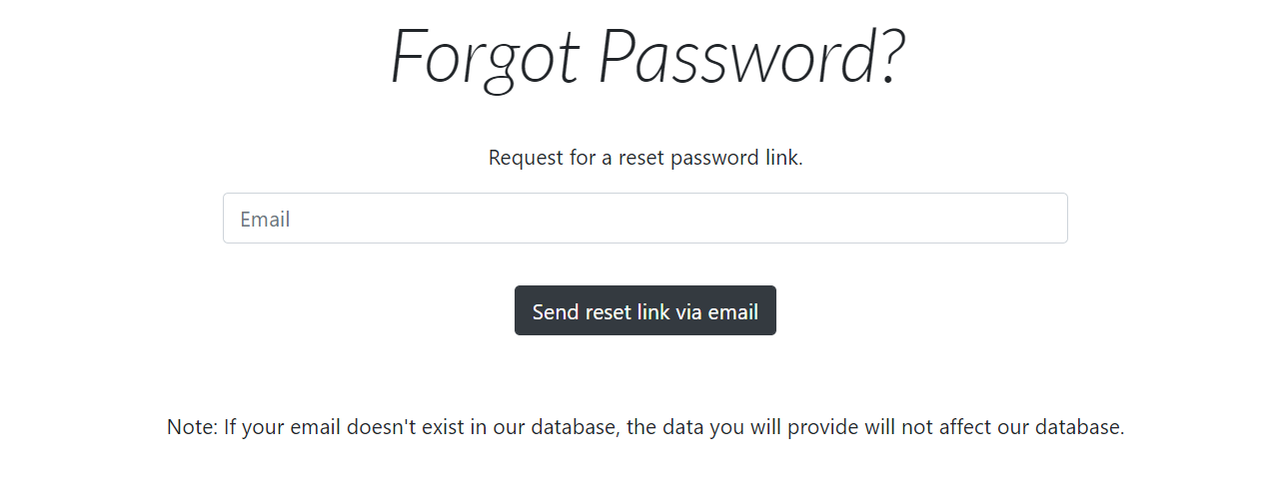
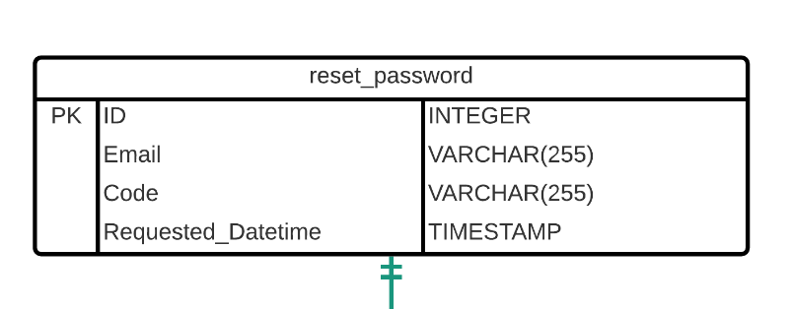
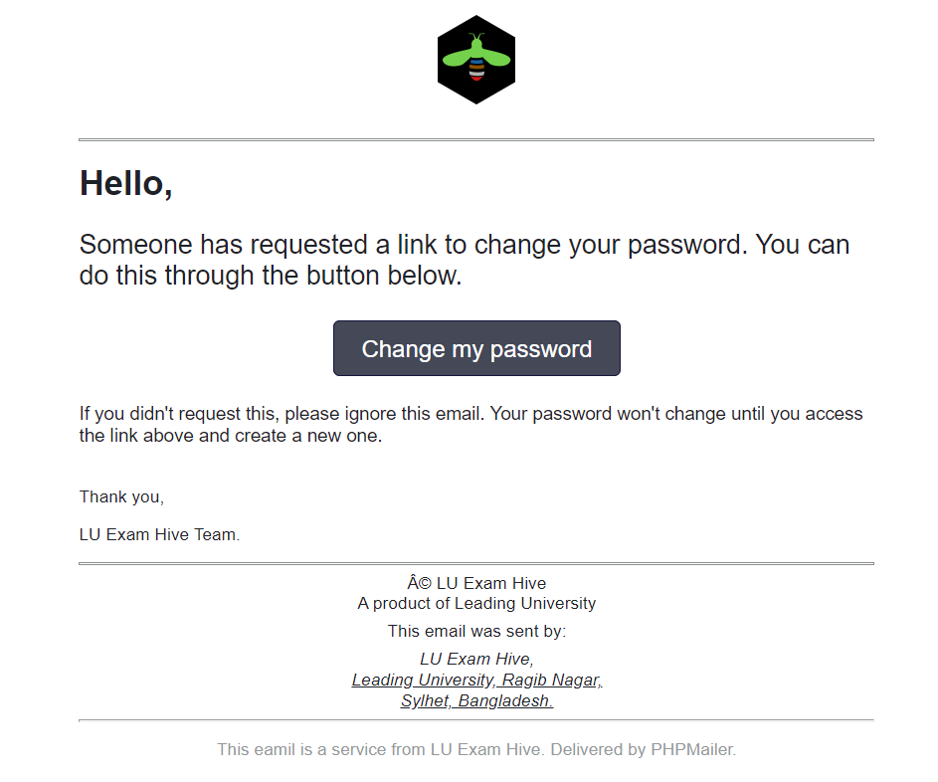
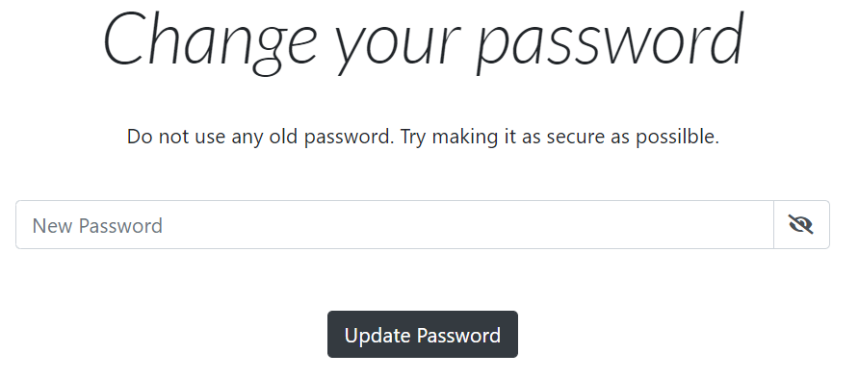
Did you forget your password again??

Slide 4
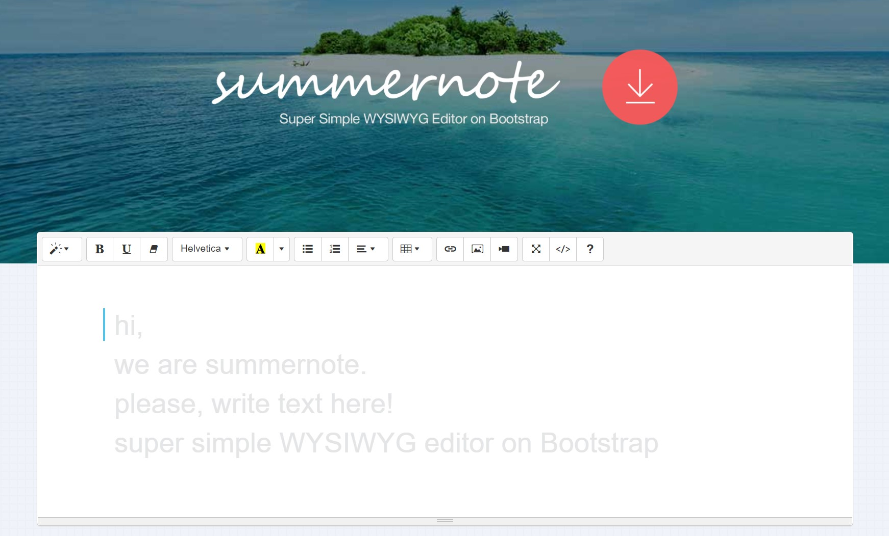
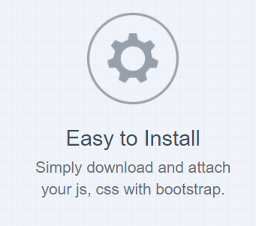

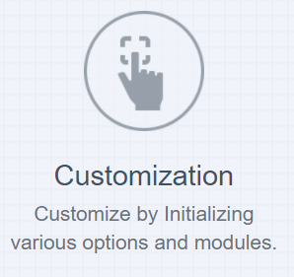
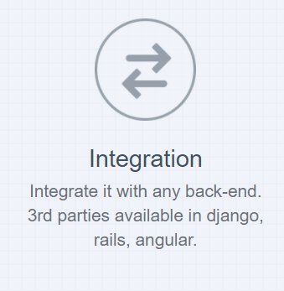
WYSIWYG Editor
Summernote is a JavaScript library that helps you create WYSIWYG editors online.

Slide 5
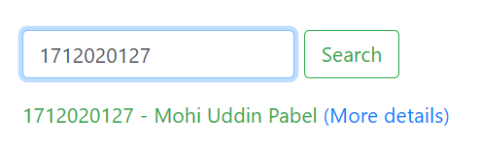
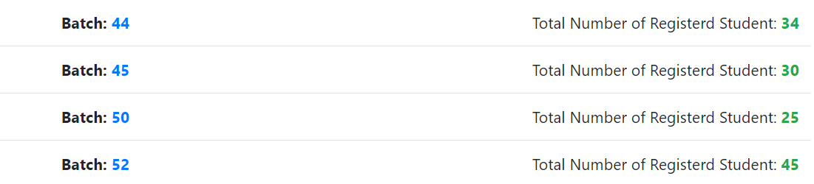
Effective Search
if (isset($_POST["search"])) {
$id = $_POST["id_to_search"];
$sql = $pdo->prepare("SELECT * FROM `Student` WHERE Student_ID = '$id'");
$sql->setFetchMode(PDO::FETCH_OBJ);
$sql->execute();
if ($row = $sql->fetch()) {?>
<p class="mt-3 text-success">
<?php echo $row->Student_ID . ' - ' . $row->FirstName . ' ' . $row->LastName . ' '; ?>
<a href="admin_student_details.php?id=<?php echo $row->Student_ID; ?>"> (More details)</a>
</p>

